Slide 1
Social Networks and Social Capital (SOCI 3102)
Don’t circulate to others without permission
Tutorial 3: QIN Xuanlong

Slide 2
Agenda
Recap
  Segmentation and Cohesion - James Moody
R Markdown
R Tutorial
  Clustering Algorithms

Slide 3
Tutorial Materials
Tutorial3_recap.html
Tutorial3.html
Dataset
  Amherst_College.csv – group 1
  Brown_University.csv – group 2
  Florida_State_Univetsity.csv – group 3
  Assignment 3-random grouping.xlsx

Slide 4
Recap – Social cohesion and connectivity
Diffusion implication of relational structure
Considering the following scenario:
  Probability that actor i infects actor j (pij)is a constant over all relations = 0.6
  S & T are connected through the following structure:
    The probability that S infects T through either path would be: 0.09
    P = 0.6 *0.6 *0.6 * 0.6 *0.6 * 0.6 + 0.6 *0.6 *0.6 * 0.6 *0.6 * 0.6 = 0.09
S
T

Slide 5
However…
Every actor but one has the exact same number of partners
The category-to-category (blue to orange) mixing is identical
The distance from S to T is the same (7 steps)
S and T have not changed their behavior
Their partner’s partners have the same behavior
But the probability of an infection moving from S to T is: = 0.186
Different structures create different outcomes
S
T
S
T

Slide 6
Structural Cohension
  “Instead of focusing on the local involvement of actors (that their friends are friends with each other, or that there are a few with many ties), we ask what relational configuration is required for a cohesive network? we focus directly on the minimum requirements for holding a network together ” - James Moody(2003, PAA)
An intuitive definition of structural cohesion:
  A collectivity is structurally cohesive to the extent that the social relations of its members hold it together.

Slide 7
The minimum requirement for structural cohesion is that the collection be connected.

Slide 8
Now imaging we increase relational volume,

Slide 9
When focused on one node, the system is still fragile. Why?
The system’s connectivity depends crucially on a single person.

Slide 10
If, on the other hand, the same number of ties are distributed widely throughout the network, many cycles form that re-connect the network, and no single star becomes the sole connector for the network.
Spreading relations around the structure make it robust to node removal.

Slide 11
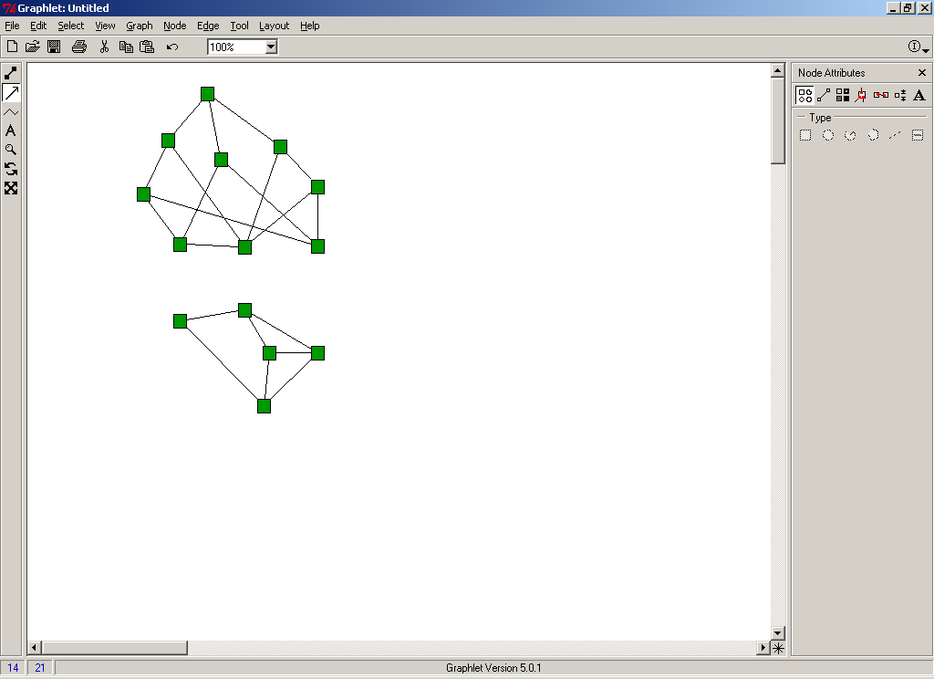
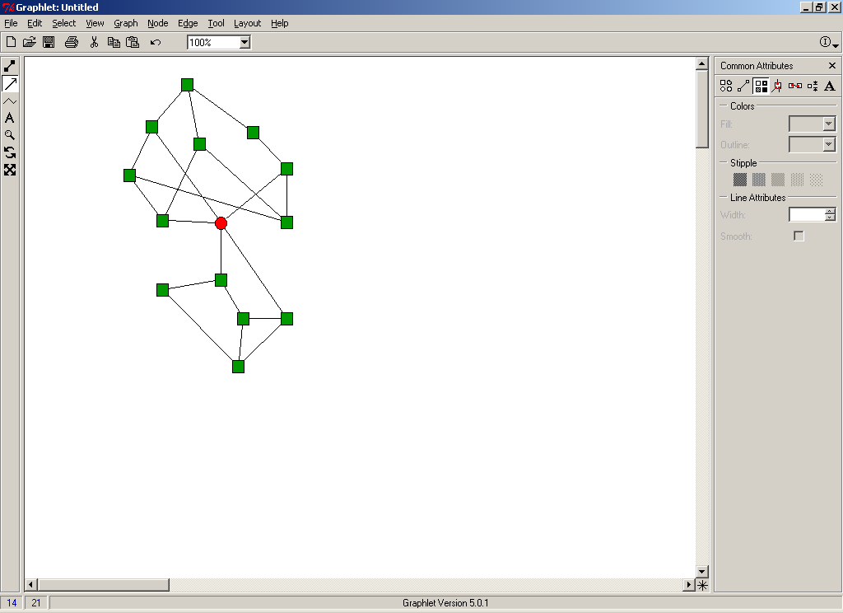
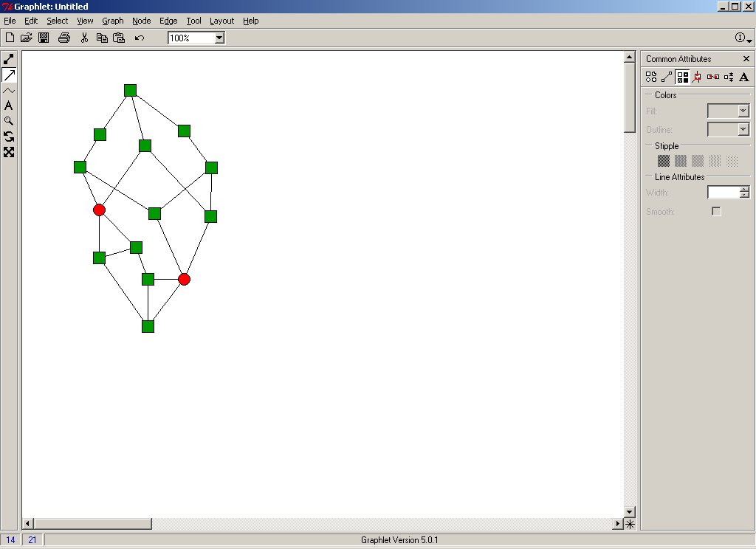
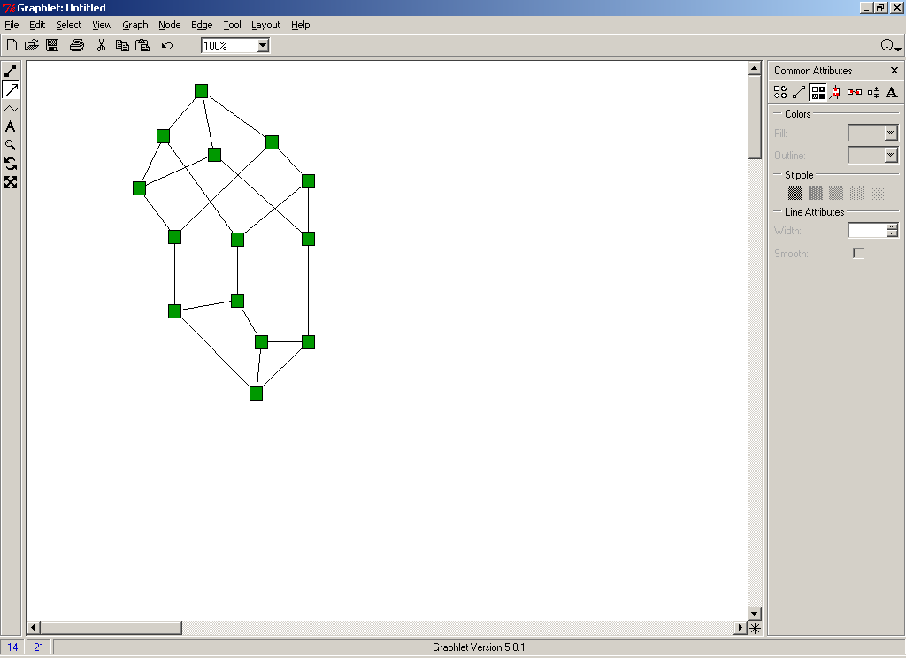
Networks are structurally cohesive if they remain connected even when nodes are removed
0
1
2
3

Slide 12
Structural cohesion gives rise automatically to a clear notion of embeddedness, since cohesive sets nest inside of each other.
2
1
3
9
4
8
10
5
7
11
12
6
13
14
17
15
18
16
19
20
2
22
23

Slide 13
There is a strong connection between the literature on “Social Capital” and group membership, which provides a theoretical link between notions of structural cohesion, ideational diffusion, and the duality of groups.
And we will learn how to conduct community detecting using clustering algorithms.

Slide 14
Community Detection
How to find communities?

Slide 15
How to automatically find such densely connected groups of nodes?
Ideally such automatically detected clusters would then correspond to real groups.

Slide 16
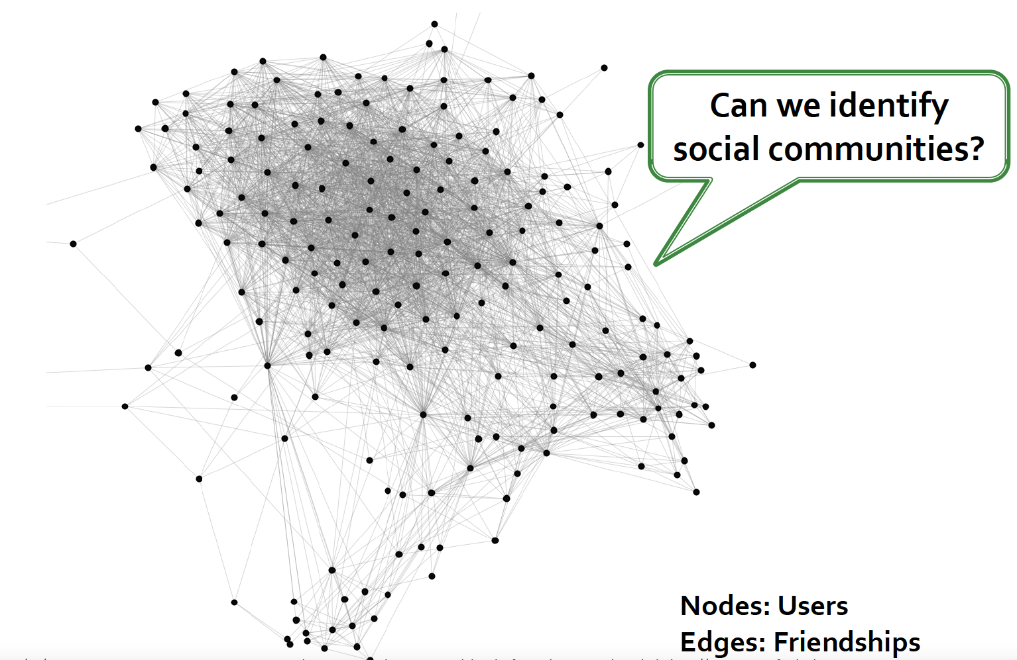
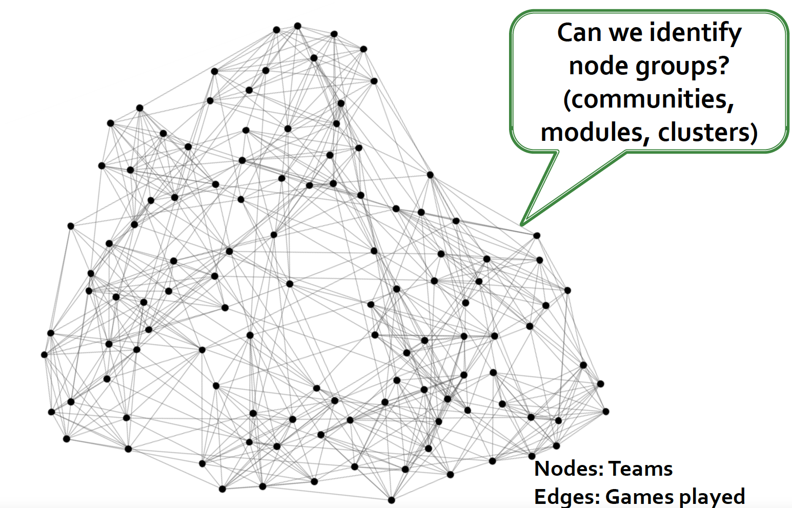
Actually, It is hard for us to find communities, modules, clusters by eyes.

Slide 17
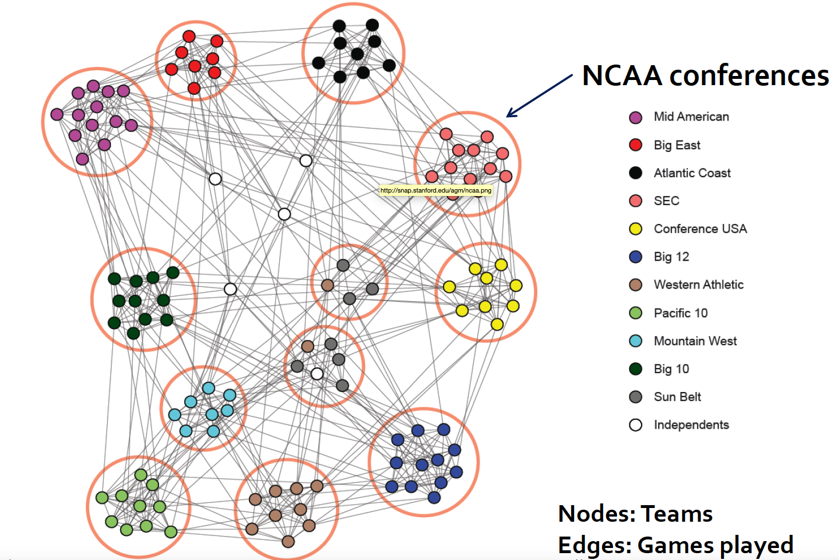
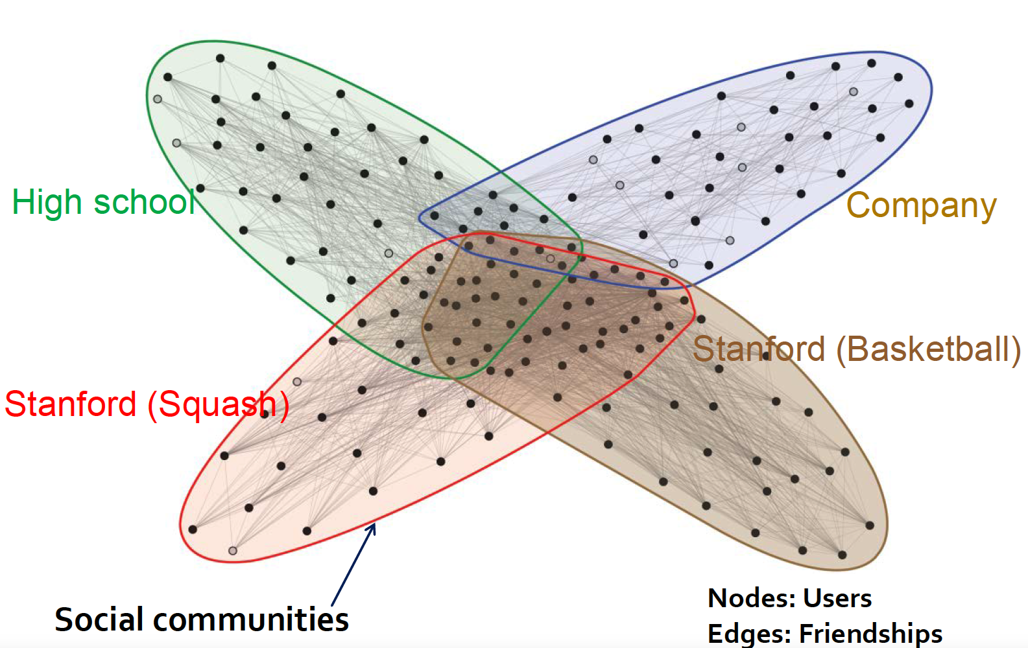
NCCA Football Networks Facebook Ego-network

Slide 18
Dataset on Graph
Then,
  We would like to borrow detection algorithms to get the communities.
The underlying data is naturally a graph
  Papers linked by citation
  Authors linked by co-authorship
  Bipartite graph of customers and products
  Web-graph
  Friendship networks: who knows whom
I will briefly introduce random walk and infomap algorithms without mathematic inference.

Slide 19
Random walk
The principle behind a random walk is quite simple: you start at a given node and then move to a neighboring node at random. This process is repeated for many steps.
In the context of social networks, a random walk can be used to measure the "closeness" of nodes based on how often a random walker visits them.
The intuition is that if many random walks starting from different nodes frequently visit a certain group of nodes, these nodes are more likely to form a community.

Slide 20


What is a random walk
t=0
t=1
1
1
1/2
1/2
1
1
1/2
1/2
t=2
t=3
1
1/2
1
1
1/2
1
1/2
1/2
Tutorial_3.Rmd file - 4. Additional Code

Slide 21
Infomap
The notion of "random walks" is not an algorithm by itself but a component that can be used in various algorithms.
The Infomap algorithm uses random walks in a more specific way. It is based on the idea of information flow and uses the concept of random walks to uncover community structures.
The algorithm uses the theory of information to find the most efficient encoding of the random walk path. In practice, this means that the algorithm seeks a partition of the network into clusters (communities) such that the description of the random walk trajectory is as short as possible.

Slide 22
Community Detection Algorithms
Some famous detection algorithms has been packed in “igraph” package.
  Louvain
  Leiden
  Walktrap
  Infomap
  Newman
  You could find more details at https://igraph.org/c/doc/igraph-Community.html

Slide 23
R Manual for SOCI 3102
More on `igraph` package
The main purpose is that you can write codes for analyzing a given network

Slide 24
Agenda
R Markdown
Recap tutorial 1 & 2
Tutorial 3: More on igraph
  Calculate Network density
  Infomap & random walk
  Personalize your graph
Introduction of Problem Set 3

Slide 25
R Markdown

Slide 26
Before we get started…
The third assignment needs to be finalized by R Markdown.
  We only receive *.Rmd + *.html file in Blackboard.
Please open Rstudio and be ready for practice.

Slide 27
What is R Markdown
R Markdown documents are fully reproducible. Use a productive notebook interface to weave together narrative text and code to produce elegantly formatted output. Use multiple languages including R, Python, and SQL.
Offical website: https://rmarkdown.rstudio.com/
install.packages("rmarkdown")

Slide 28
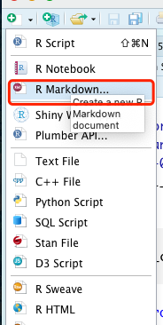
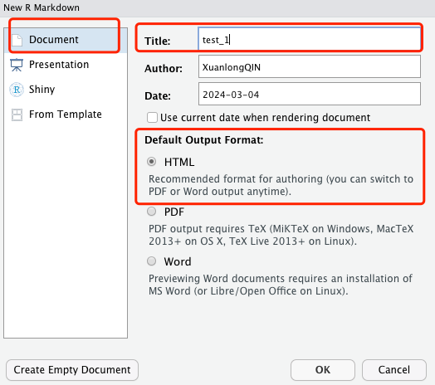
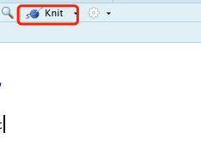
New a markdown script
Knit and Save your file

Slide 29
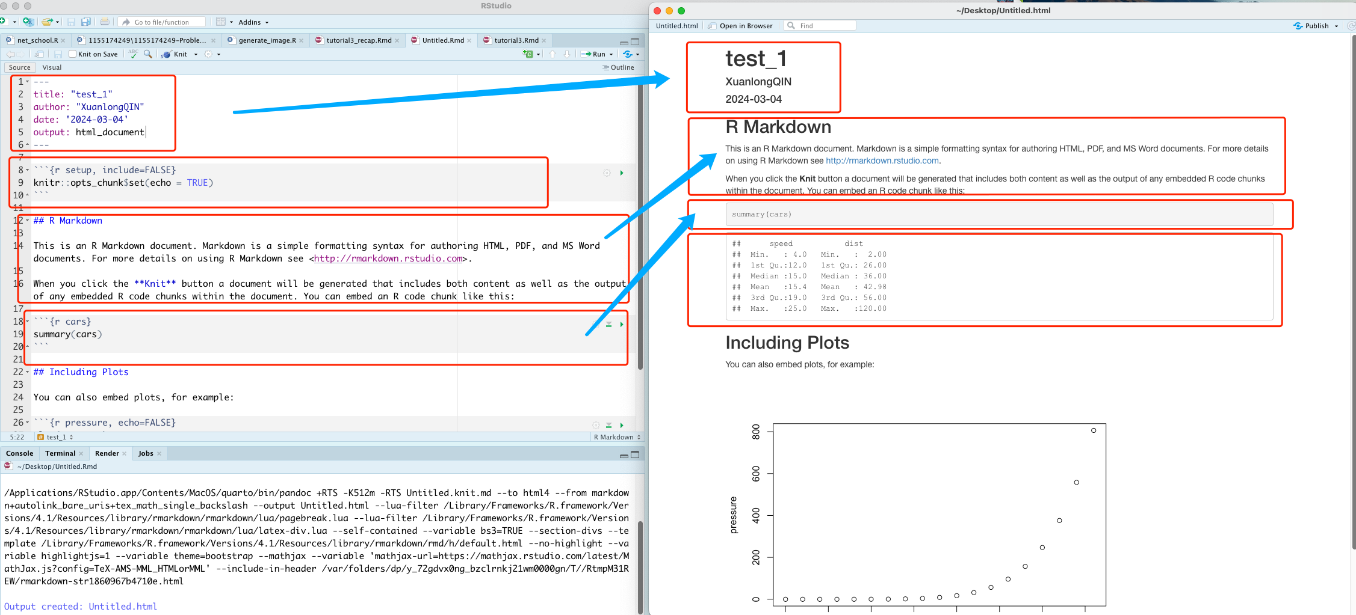

Slide 30
Chunk Options
Chunk output can be customized with knitr options, arguments set in the {} of a chunk header. Above, we use five arguments:
  include = FALSE prevents code and results from appearing in the finished file. R Markdown still runs the code in the chunk, and the results can be used by other chunks.
  echo = FALSE prevents code, but not the results from appearing in the finished file. This is a useful way to embed figures.
  message = FALSE prevents messages that are generated by code from appearing in the finished file.
  warning = FALSE prevents warnings that are generated by code from appearing in the finished.
  fig.cap = "..." adds a caption to graphical results.
See the R Markdown Reference Guide for a complete list of knitr chunk options.
Generally, I won’t compulsorily ask you to change the default setting, and in our tutorial, you could ignore these code chunks.

Slide 31

If it can not work,
install.packages(“evaluate”)
install.packages(“knitr”)

Slide 32
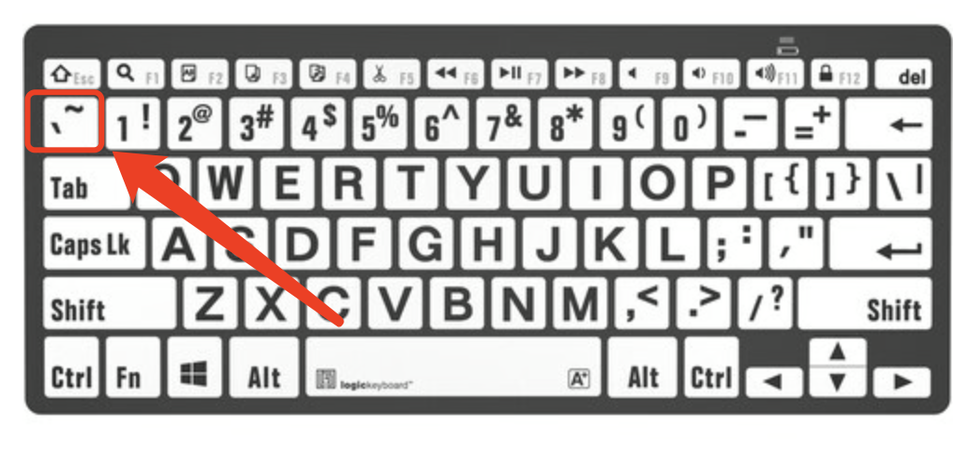
Basic Symbol
Bash --- for header
Backquote ` for R code chunks
Parentheses {} for code formatting
Number # for annotations

Slide 33
Recap: Tutorials Overview
Based on R Markdown

Slide 34
Tutorial 1,
  Install R, R Studio, install certain network packages, review and application of basic network concepts
Tutorial 2,
  Basic & data manipulation in R, building network graphs
Tutorial 3.
  More on network graphs and basic network statistics in R

Slide 35
Basic concepts
Data type
  Vector, Matrix, Array, Data Frame, Lists
View Dataset
Data descriptions
Input external data
Help function
Please open tutorial3_recap.rmd file by RStudio

Slide 36
Basic `igpaph` package
Install igraph
Create simple graph
Indicators of Networks
How to personalized your network
Please open tutorial3_recap.rmd file by Rstudio

Slide 37
Tutorial 3: More on igraph
Community detection

Slide 38
Community detection
1. Check and clean data
2. Calculate Network Density
3. Conducting Clustering Algorithms (Take walktrap as an example)
4. Define the colors for different communities
Please open tutorial3.Rmd file by Rstudio
Tutorial_3.Rmd file - 4. The Zachary Karate Club

Slide 39
About Problem Set 3

Slide 40
Datasets - Academic citation network
The datasets include the fields of articles published by the university in 2011 and the fields of these papers’ references.
  E.g. “Information flow through strong and weak ties in intraorganizational social networks”, “Social Science”, “Medical Innovation: A Diffusion Study”, “Medicine”
  Then, “Social Science”,” Medicine” were recorded.
I collected three universities' published papers in 2011 as our datasets.
Three universities (Amherst College, Brown University, and Florida State University)
  Liberal and arts, Science
  Status
  Three datasets will be randomly assigned to each student.

Slide 41
Data description
Data description
  Each dataset have two columns
  Original: a paper from a specific field
  Destination: the field of cite paper
  For instance, A, Computer Science, B, Sociology.
    A Cited B
    a directed network

Slide 42
Notes:
1. you should set a fix random seed.
  set.seed(123)
2. Please check whether the code I gave is available.
  Ensuring the Return value is true !!!
3. Everyone must submit their assignment by *.Rmd + *.html format.
  Prefer “student ID_name_group.Rmd”
  i.e. 1155186031_xuanlong_group1.Rmd
  Pack them in rar format
4. You have extra one week for finish this assignment.
  Due: 28th, Mar.

